Slide 1
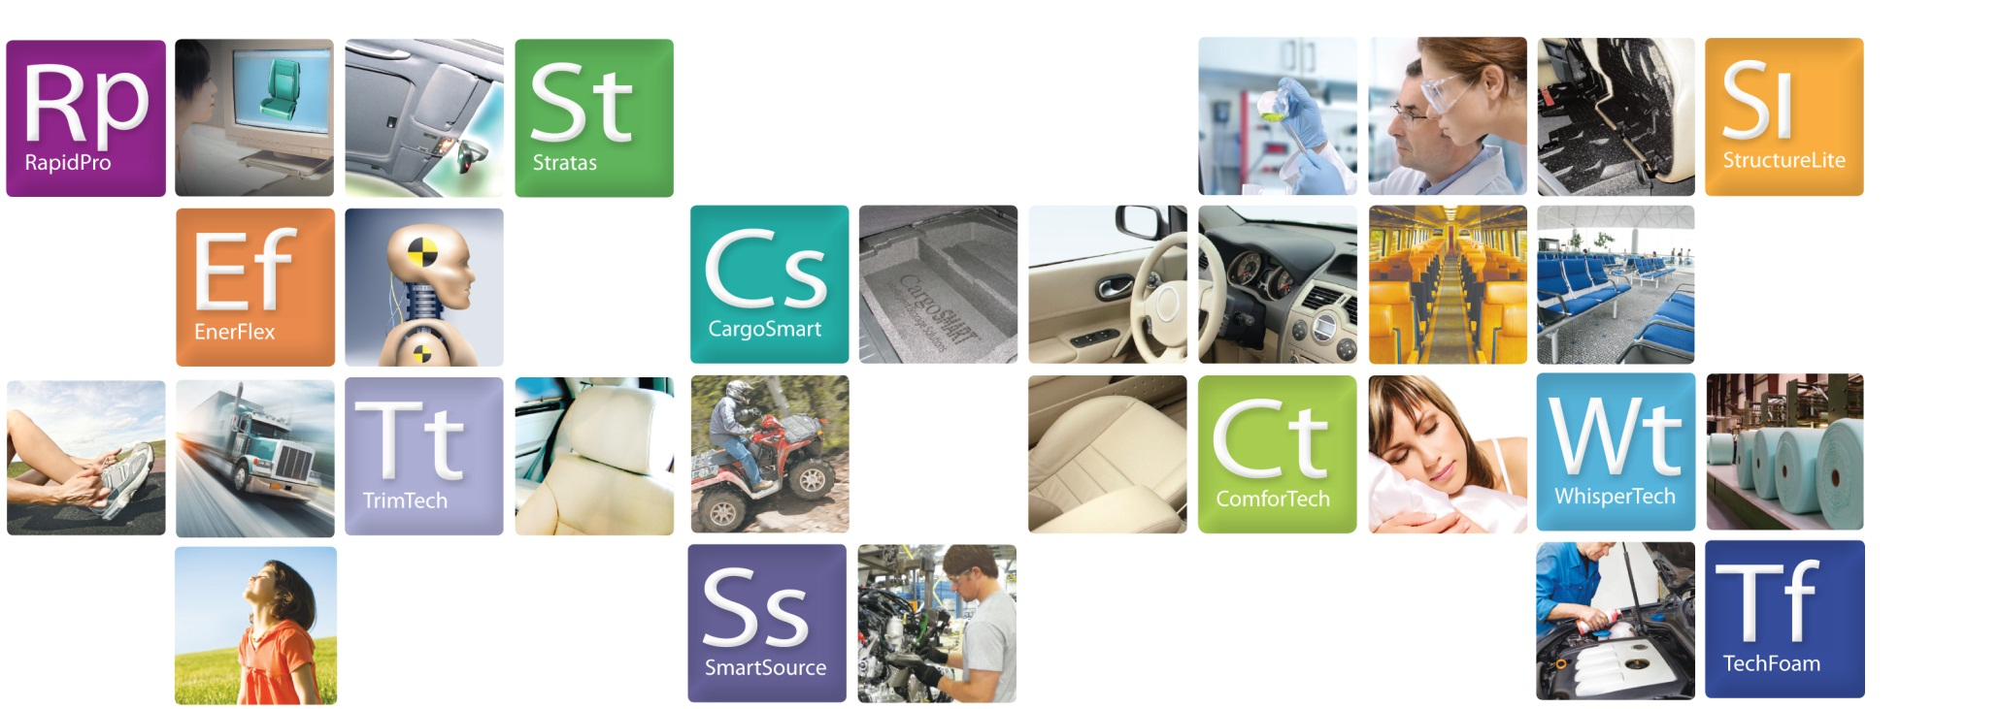
Elements of Woodbridge
Tracker Database
James Hare, Richard Kimsey, Javier Martinez, Daniel Velasquez

Slide 2

We are proud to be part of a project that will benefit the employees who work with this business critical database everyday. Not only will this project help employees with their jobs, but it also helped our senior development team to better understand the Software Development Life Cycle and gain valuable experience in working to develop a software product for a customer.

Slide 3
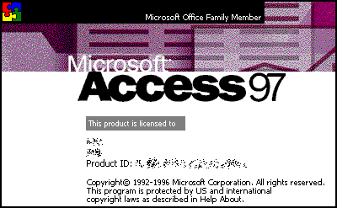

Software Requirements Specifications
Prioritized Business Requirements
Phase Planning and Waterfall SDLC
Software Peer Reviews
QA & Regression Testing
Finalized deliverables to client

Slide 4
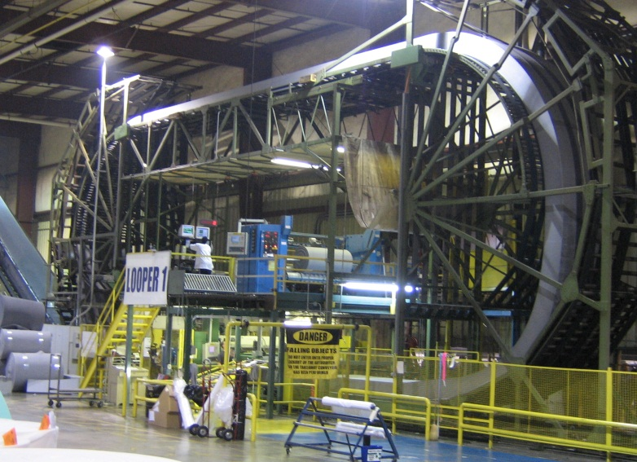
A machine center where part of the business requirements were gathered during the software requirements specification process.

Slide 5

T
A
S
K S
Build Audit Tables
Add Input Field Restrictions
Implement Microsoft Account login
Add Triggers to Form Processes
Standardize Table Measurements
Record Database User Entries
Globally Update Form Logos
Update Microsoft Access Version

Slide 6
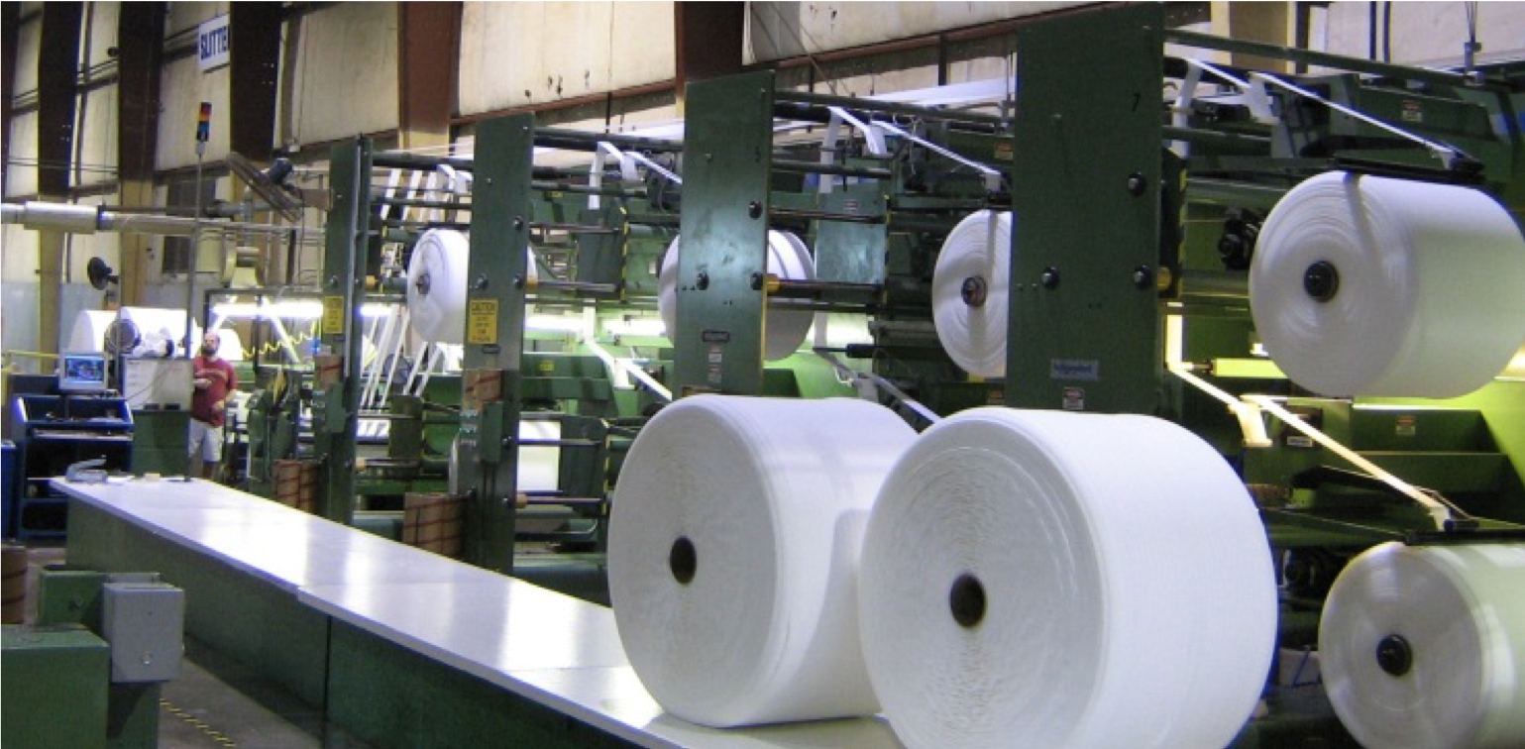

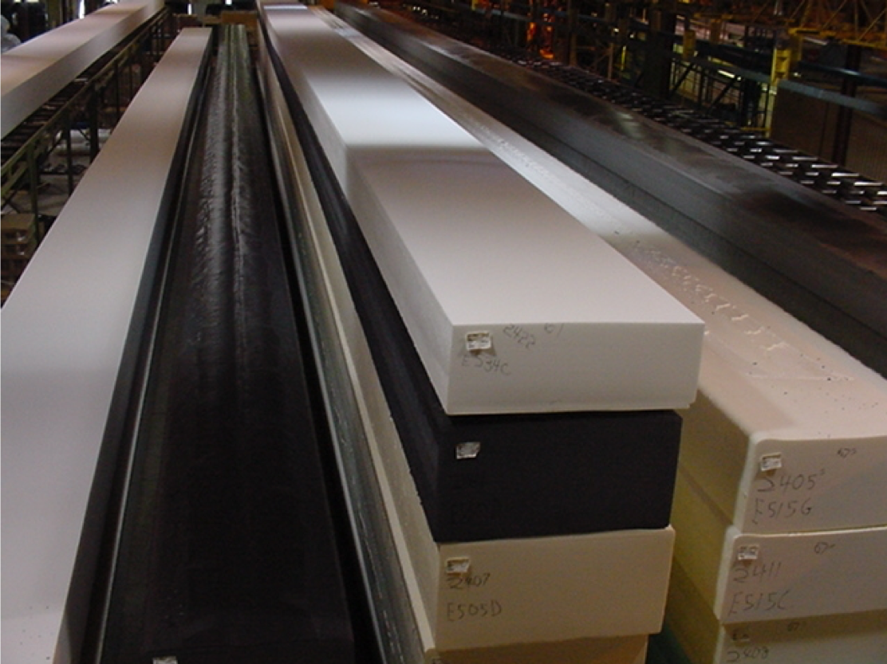
D
A
T
A
M
O
D
E
L
Systex
Shipping
Tracker DB
Customers
Project Database
Network
Dependencies
Machine Centers

Slide 7

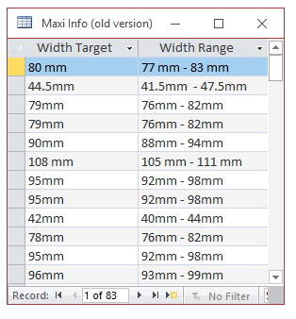
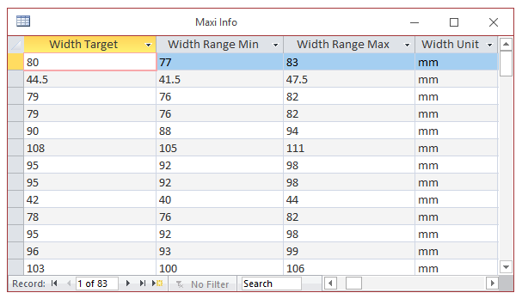
R
E
S
U
L
T
S

Slide 8
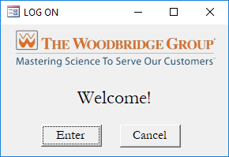

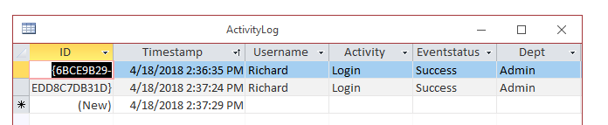
R
E
S
U
L
T
S

Slide 9
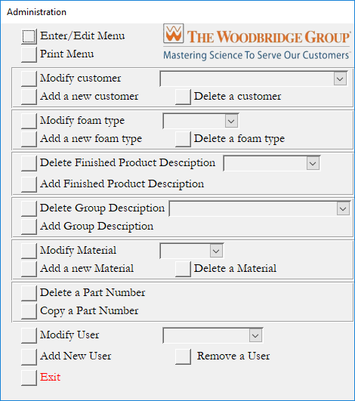
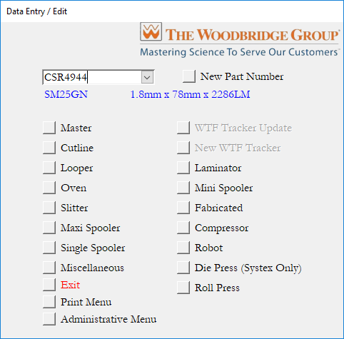
R
E
S
U
L
T
S

